Slide 1
Lecture 3 – Important Problem Types
CST370 – Design & Analysis of Algorithms
Dr. Byun
Computer Science

Slide 2
Lecture Objectives
After completion of this lecture, you will be able to
  recognize the importance of algorithms in computer science.
  present important problem types in algorithms such as sorting, searching, graph problems, etc.

Slide 3
Why do you study algorithms?
You can learn a set of standard algorithms in different computing areas.
You will be able to design a new algorithm to solve a new problem and analyze the efficiency of your algorithm.
It is the cornerstone of computer science.
  Computer programming doesn’t exist without algorithms.
  It is also considered a common troubleshooting strategy.

Slide 4
Google Recruiter’s Email
The following is a part of an email from a Google recruiter to our student who had a job interview with them.
  Many problems will be about algorithms.
  Algorithm Complexity: You need to know Big-O. If you have difficulty analyzing the basic Big O complexity, you will rarely be hired.
  Sort: You should know how to sort.
  Hashtables: Probably the single most important single data structure known to mankind. ...
  Tree: ...
  Graph: ...
  Other data structures: As many different data structures and algorithms as possible should be studied.

Slide 5
Chapter 1: Introduction
1.1 What is an Algorithm?
1.2 Fundamentals of Algorithmic Problem Solving
1.3 Important Problem Types
1.4 Fundamental Data Structures

Slide 6
Important Problem Types
This section briefly introduces the most important problem types in algorithms.
  Sorting
  Searching
  String processing
  Graph problems
  Combinatorial problems
  Geometric problems
  Numerical problems

Slide 7
Sorting
Sorting is to arrange items in either ascending order or descending order.
  Sometimes, we call it non-ascending order or non-descending order.
Why is the sorting important in CS?

Slide 8
Sorting – Time Efficiency
So far, many sorting algorithms have been proposed.
O(n*logn) is considered the fastest one for comparison-based sorting.
  If you don’t know the meaning of the notation O(n*logn), that is fine.
  We will cover the notation O later.

Slide 9
Stable Sorting
A sorting algorithm is said to be stable if the algorithm keeps the relative order of equal elements in its input.

Slide 10
Stable Sorting – Example
Input: 5, 4, 3, 4, 12, 4
Output: 3, 4, 4, 4, 5, 12

Slide 11
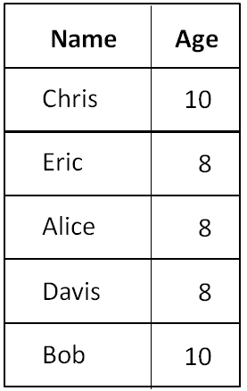
Why do we need a stable sorting? (1 of 3)
Assume that we have an excel file with several columns such as names and ages.

Slide 12
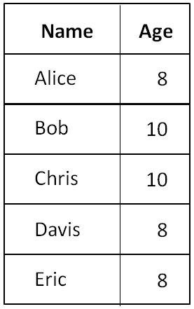
Why do we need a stable sorting? (2 of 3)
Suppose we want to sort the file by names.
  This is the result.
  ➔

Slide 13
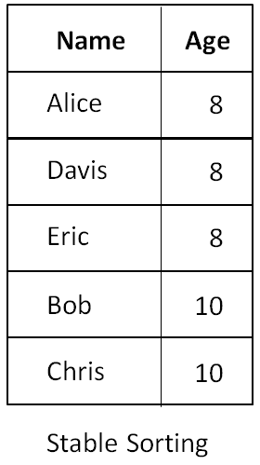
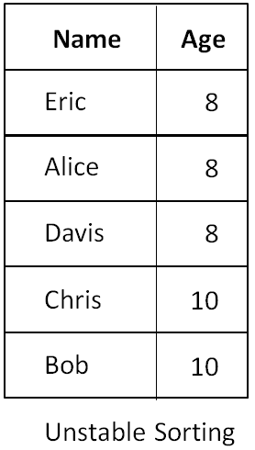
Why do we need a stable sorting? (3 of 3)
Now, let’s say we want to sort the result by ages.
  Which result do you like?
  ➔

Slide 14
Stable vs. Unstable Sorting
Stable sorting algorithms
  Merge sort, insertion sort, bubble sort, etc.
Unstable sorting algorithms
  Quick sort, heap sort, selection sort, etc.
Don’t misunderstand that stable sorting is always better than unstable sorting.
  You should choose according to your needs.

Slide 15
In-Place Sorting Algorithm
An algorithm is said to be in-place if it does not require a lot of extra memory, except for a few memory units.
  For example, if your algorithm requires an array to hold the input data and a few primitive variables to conduct the sorting, you can say that your algorithm is “in-place”.
  However, if your algorithm requires additional array(s), your algorithm is not “in-place”.
In-place sorting
  Bubble sort, selection sort, insertion sort, heapsort, quicksort, etc.

Slide 16
Searching
Finding a given value, called a search key, in a given set.
  e.g., sequential search, binary search, hashing, etc.

Slide 17
String Processing
String examples
  Text strings, bit strings, gene sequences, etc.
One important problem
  String matching problem: searching for a word in a word file.
Example
  Word file: I like the C++ programming and Java programming. They are good languages.
  You will use “Control-F” to find a word like “pro”.

Slide 18
Simple String-matching Algorithm

Slide 19
Puzzle: Three mislabeled baskets (1 of 2)
Suppose that there are three baskets on a desk.
  One basket contains an apple, another basket contains an orange, and the last basket contains an apple and an orange.
Now, let's assume that each basket has a label outside like “Apple”, “Orange”, and “Mix”.
  The problem is that the labels are always mislabeled. For example, if the label says “Mix”, you can be sure that the basket is never actually a blend of an apple and an orange, i.e. it actually contains either an apple or an orange.

Slide 20
Puzzle: Three mislabeled baskets (2 of 2)
In this puzzle you can choose only one basket to see what is in it.
Which basket should you choose to label all three properly?

Slide 21
Solution

Slide 22
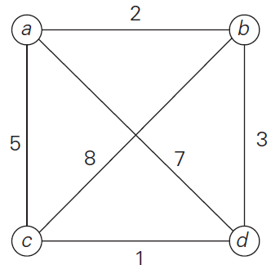
Graph Problems (1 of 2)
A graph in computer science is composed of nodes (= vertices) and lines (= edges).
Example
SEA
CHI
SFO
JFK
LAX

Slide 23
Graph Problems (2 of 2)
A graph is used for modeling many real-life applications.
  e.g.,: transportation, communication networks, project scheduling, etc.
Graph traversal problem
Shortest-path problem

Slide 24
Traveling Salesman Problem (TSP)
Watch the video first
  https://youtu.be/67DMNFzzIpo
It is one of the best known graph problems in computer science.
The travelling salesman problem (TSP) asks the following question: "Given a list of cities and the distances between each pair of cities, what is the shortest possible route that visits each city exactly once and returns to the origin city?"

Slide 25
TSP Example
Assume that you start a traversal for the following graph from the node a.
  What is the optimal travel path and travel cost?

Slide 26
TSP Example – Solution
There are two optimal paths (or tours)
  a → b → d → c → a
  a → c → d → b → a
The travel cost will be 11.

Slide 27
Combinatorial Problems
Finding a combinatorial object - such as a permutation, a combination or a subset - that satisfies certain constraints and has some desired property (e.g., maximize a value or minimize a cost).
Examples
  TSP, knapsack problem, etc.
Most difficult problems in computing.
  The number of combinatorial objects typically grows extremely fast.

Slide 28
Knapsack Problem
Watch this video from start to 2:29.
  https://youtu.be/OC85aM7SFts
  After 2:29, the video presents a solution to solve it. You don’t need to study it yet.
Given n items
  weights: w₁, w₂, . . . , w_{n}
  values: v₁, v₂, . . . , v_{n}
Find the most valuable subset of the items that fit into a knapsack with the capacity W.
Note that there is only one quantity per item.

Slide 29
Example
Knapsack capacity: 10 (i.e.: W = 10)
Item 1: w₁ = 7, v₁ = $42
Item 2: w₂ = 3, v₂ = $12
Item 3: w₃ = 4, v₃ = $40
Item 4: w₄ = 5, v₄ = $25

Slide 30
Geometric Problems
Deal with geometric objects such as points, lines, and polygons.
  Many applications in computer graphics, robotics, and tomography.
Closest-pair problem: Given n points in the plane, find the closest pair among them.
Convex-hull problem: Find the smallest convex polygon that would include all points of a given set.

Slide 31
Convex-Hull Problem
Convex hull
  Given a set of n points in the plane, find the minimum convex area that contains all the points.
Example

Slide 32
Numerical Problems
Originally, a computer was developed to solve many mathematical problems such as solving equations, computing definite integrals, etc.
  However, the focus has shifted to business applications.
  They are still important.

